Slide 1

Jaeger

Slide 2
Introduction
Most popular open source distributed tracing backend.
CNCF Graduated project.
Created & open sourced by Uber Technologies.
Used for monitoring and troubleshooting microservices-based distributed systems.

Slide 3
Features
Open Tracing-inspired data model.
Multiple built-in storage backends.
Cassandra
Elasticsearch
in-memory
Community supported external storage backends.
System topology graphs.
Adaptive sampling.
Service Performance Monitoring (SPM).

Slide 4
Architecture
Jaeger can be deployed either as an all-in-one binary.
Where all Jaeger backend components run in a single process, or as a scalable distributed system.
There are two main deployment options.
Direct to storage
Kafka

Slide 5
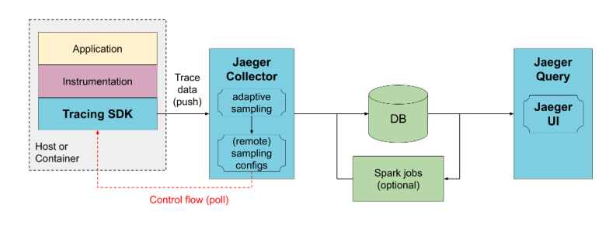
Direct to storage

Slide 6
Collectors receive the data from traced applications and write it directly to storage.
The storage handles both the average and peak traffic.
Collectors use an in-memory queue.
Collectors serve sampling configuration to the SDKs known as remote sampling mode.
Also enable automatic sampling configuration calculation, known as Adaptive sampling.

Slide 7
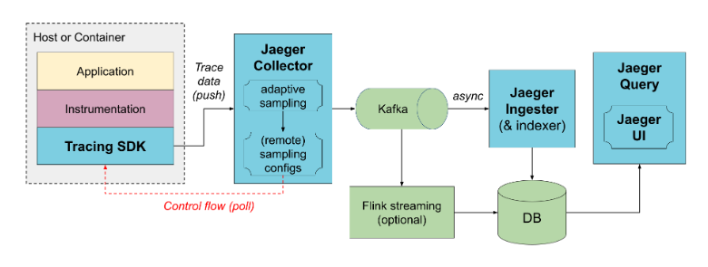
Kafka

Slide 8
To prevent data loss between collectors and storage, Kafka can be used as persistent queue.
Jaeger-ingester, needs to be deployed to read data from Kafka and save to the database.
Multiple jaeger-ingesters can be deployed to scale up ingestion.
And they will automatically partition the load across them.

Slide 9
Jaeger Tracing Glossary
Client-The component that implements the OpenTracing API for distributed tracing.
Agent-A network deamon that listens for spans sent over User Datagram Protocol.
Collector-The component that receives spans and adds them into a queue to be processed.
Console-A UI that enables users to visualize their distributed tracing data.
Query-A service that fetches traces from storage.
Span- The logical unit of work in jaeger, which includes the name , starting time and the duration of the operation.

Slide 10
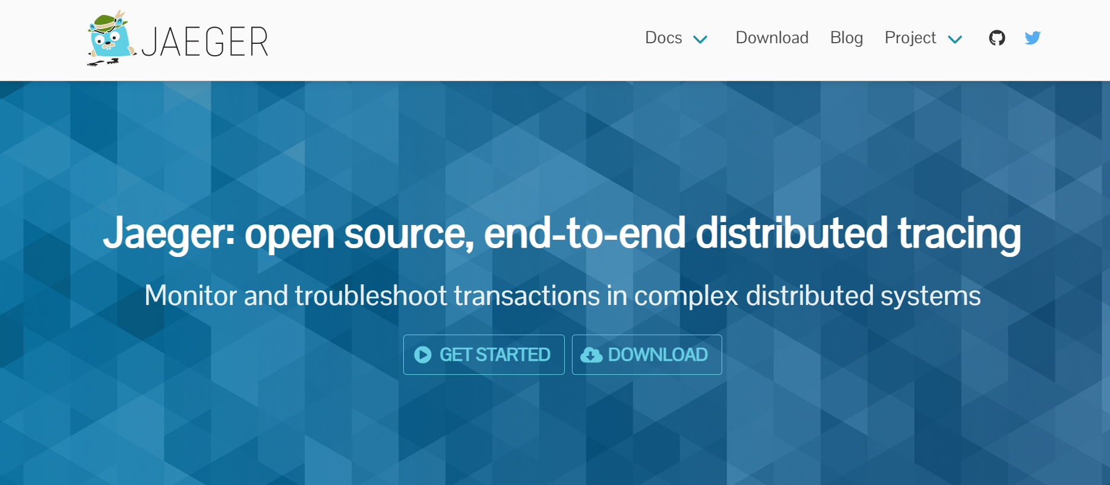

Slide 11
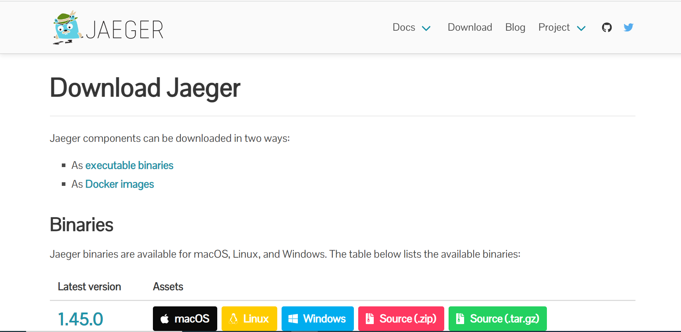

Slide 12
Components
Tracing SDKs
Agent
Collector
Query
Ingester

Slide 13
Tracing SDKs
The Jaeger project provided a collection of tracing SDKs, called Jaeger clients.
These libraries have been retired in favor of the Open Telemetry SDKs.
Agent
Jaeger agent is deprecated.
The Open Telemetry data can be sent directly to the Jaeger backend, or the Open Telemetry Collector can be used as agent.
Collector
Jaeger-collector receives traces, runs them through a processing pipeline for validation and clean-up and stores them in a storage backend.

Slide 14
Query
Jaeger-query is a service that exposes the APIs for retrieving traces from storage .
It hosts a Web UI for searching and analyzing traces.
Ingester
Jaeger-ingester is a service that reads traces from Kafka and writes them to a storage backend.
It is a stripped-down version of the Jaeger collector that supports Kafka as the only input protocol.

Slide 15
Thank You

